Slide 1

ECO GUARDIAN: LOCATION BASED GARBAGE MANAGEMENT SYSTEM FOR SMART CITY
Team Members:
Tousif Mahmud Emon (1901011)
Md. Muntasire Mahmud (1901012)
Sharika Khan (1901013)
Shakil Ahmed (1901023)

Slide 2
INTRODUCTION
The Location-Based Garbage Management System is a digital solution designed to optimize garbage management in smart cities.
By leveraging mobile technology, implementing IoT sensors, and getting real-time data to monitor and manage garbage collection processes efficiently.
By providing real-time insights and tools for route optimization, the application aims to revolutionize urban waste management practices.

Slide 3
MOTIVATION
Traditional Challenges
Technological Innovation
Static garbage collection schedules leading to overflows and can be missed.
With the use of advanced technology to revolutionize waste management practices.
Real Time Monitoring
Resource Optimization
Ensuring timely collection and reducing the risk of overflowing bins.
Sustainability Alignment
Optimizing waste collectors allocation for efficiency and load distribution.
Key component of sustainable cities, pollution reduction, and improved quality of life.

Slide 4
OBJECTIVES
Environmental Sustainability
Efficient Waste Collection
Optimize waste collection routes to minimize environmental impact
Continuous monitoring of trash bin fill levels with sensors.
Public Health Improvement
Informed Decision Making
Maintain clean and hygienic public spaces.
Empower administrators to allocate resources effectively with real time data

Slide 5
RELATED WORKS
This paper introduces a smart city garbage management system using sensors to detect bin levels, alerting via an Android app, and GPS for precise bin location, reducing monitoring time.
Garbage Management System
for Smart City
Location Based Garbage Management System with IoT for Smart City
This paper suggests a cost-effective IoT solution for smart city garbage management, optimizing collection routes and providing a mobile app for citizens and workers.
Location Based Garbage
Management System for Smart City
This paper proposes a web-based garbage management system for smart cities, optimizing collection routes and providing an app for citizens and workers.

Slide 6

KEY FEATURES
Real Time Monitoring
Resource Management
Continuous monitoring of garbage bins fill levels using sensors data.
Centralized dashboard to monitor system-wide operations.
Efficient route planning based on the bins locations.
Intuitive and easy-to-use mobile application for the user.
Bin Location Tracking
User Friendly Mobile App

Slide 7
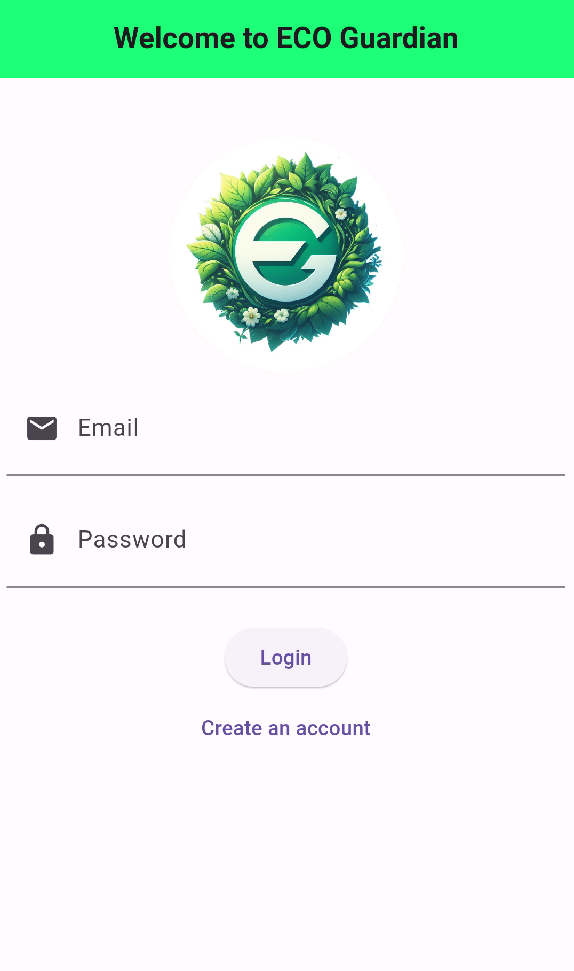
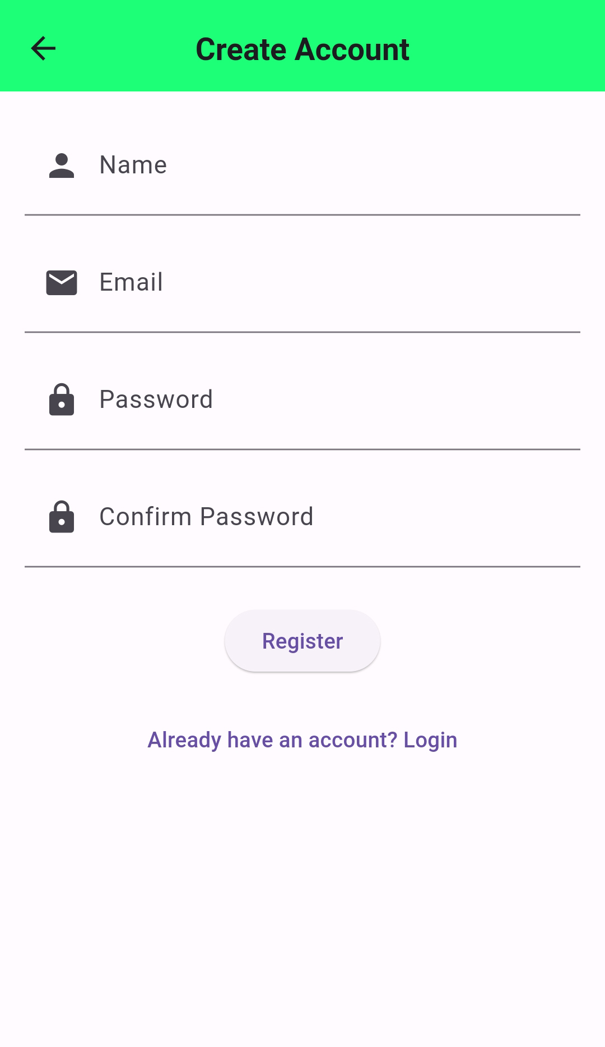
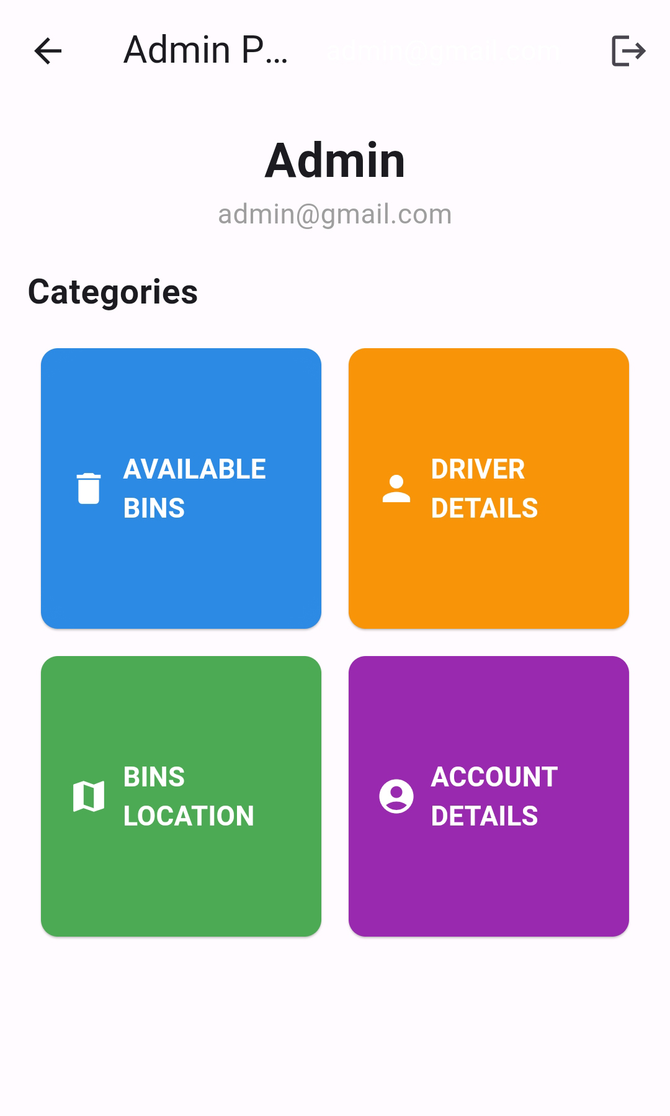
APP VIEW
LOGIN
REGISTRATION
HOME PAGE

Slide 8
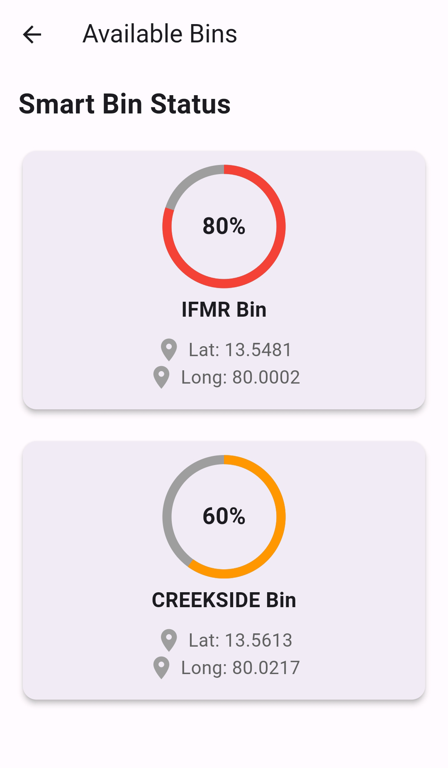
APP VIEW: AVAILABLE BINS
HOME PAGE
AVAILABLE BIN

Slide 9
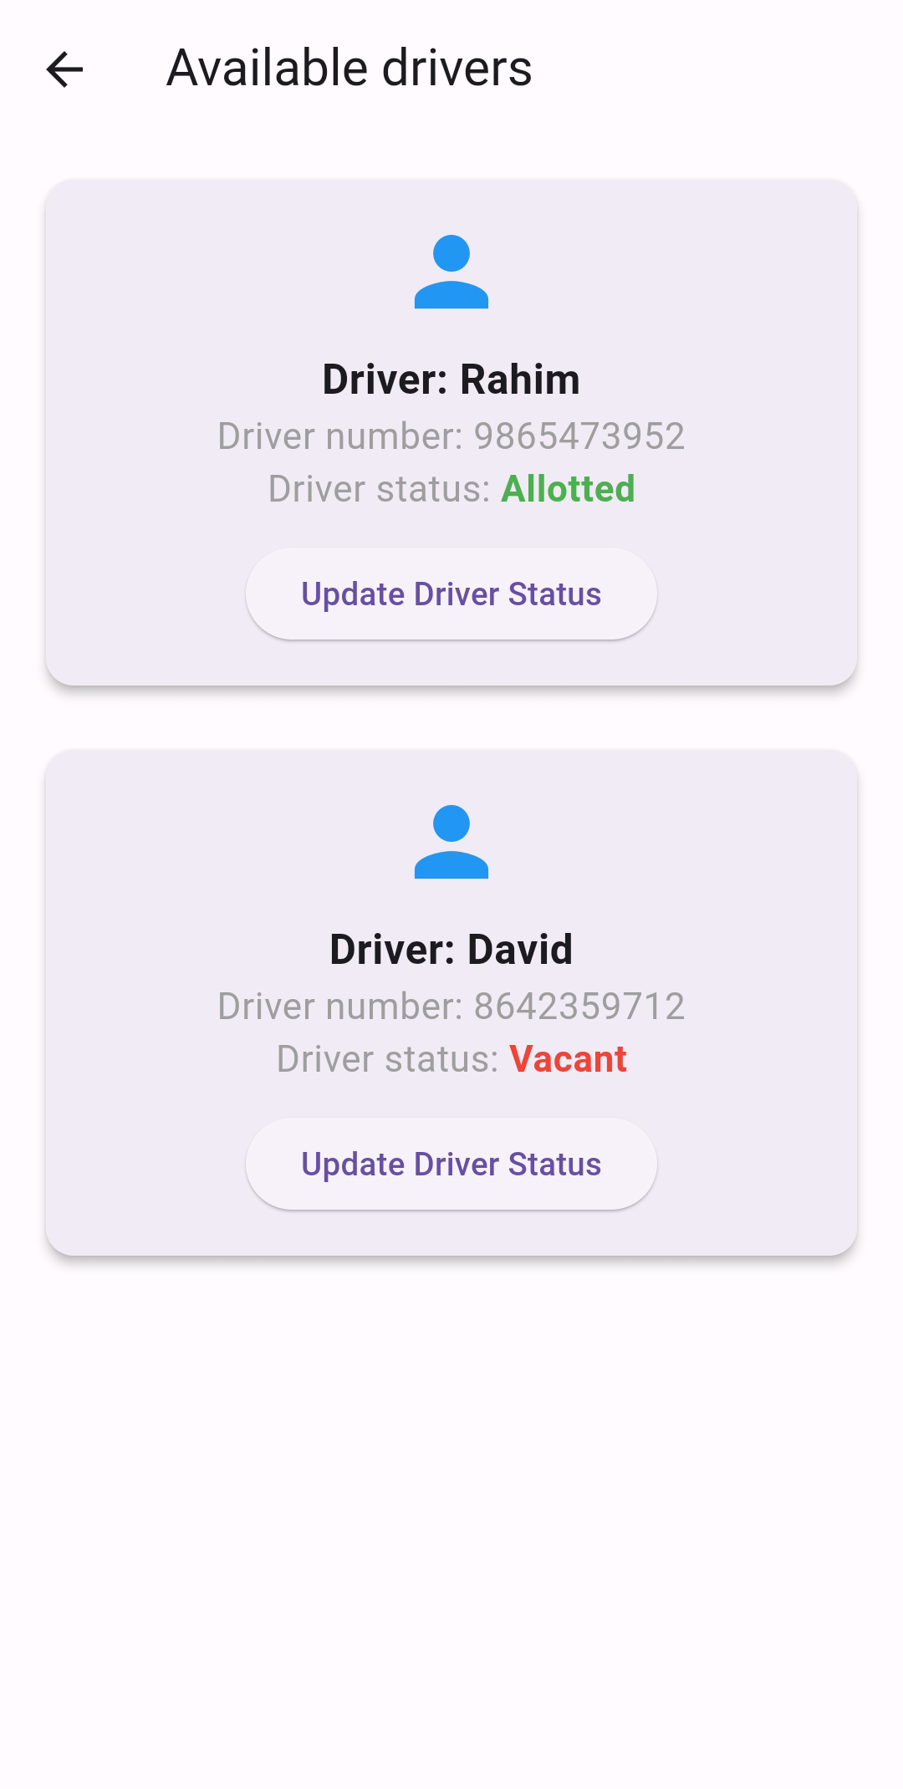
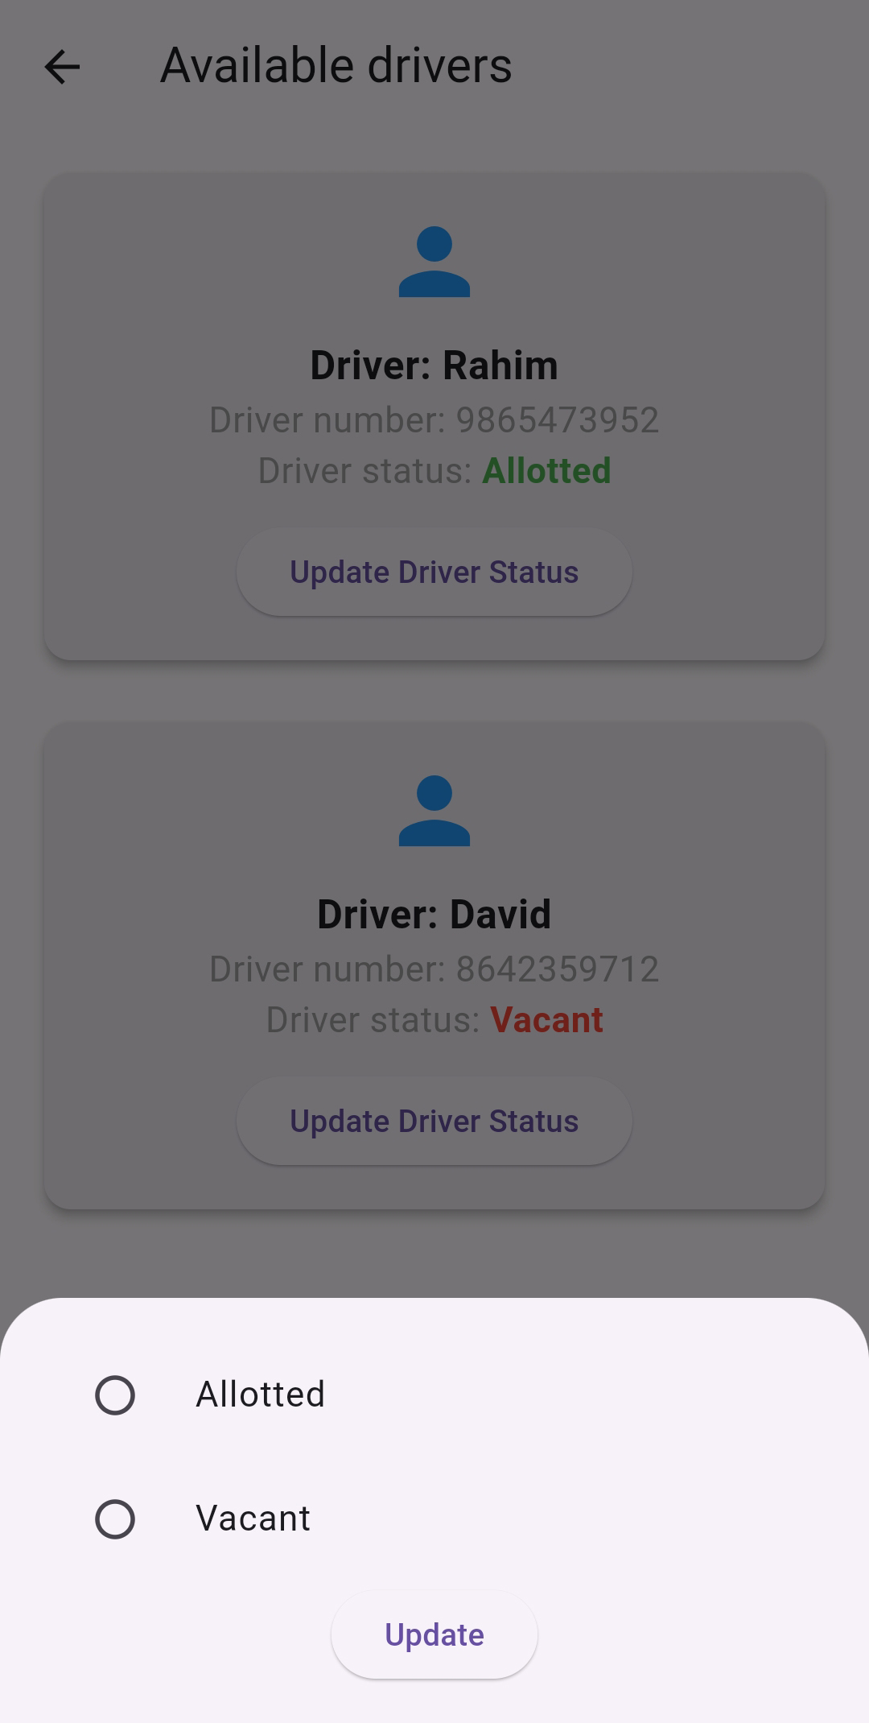
APP VIEW: DRIVER DETAILS
HOME PAGE
DRIVER DETAILS
DRIVER STATUS

Slide 10
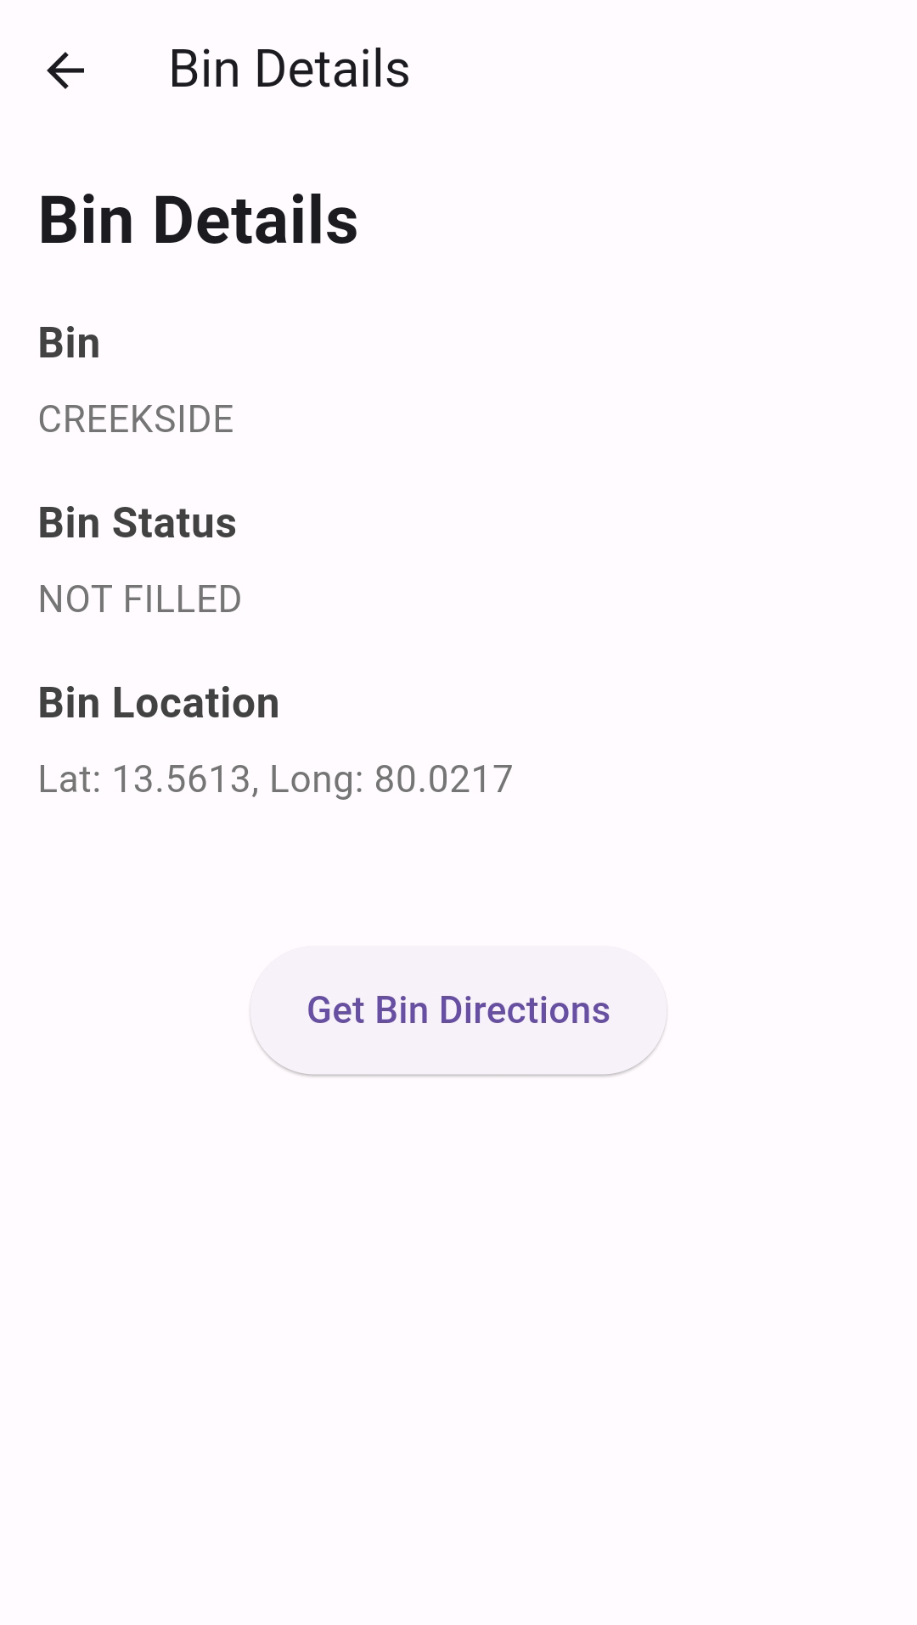
APP VIEW: BINS LOCATION
HOME PAGE
BIN LOCATION
BIN DETAILS

Slide 11
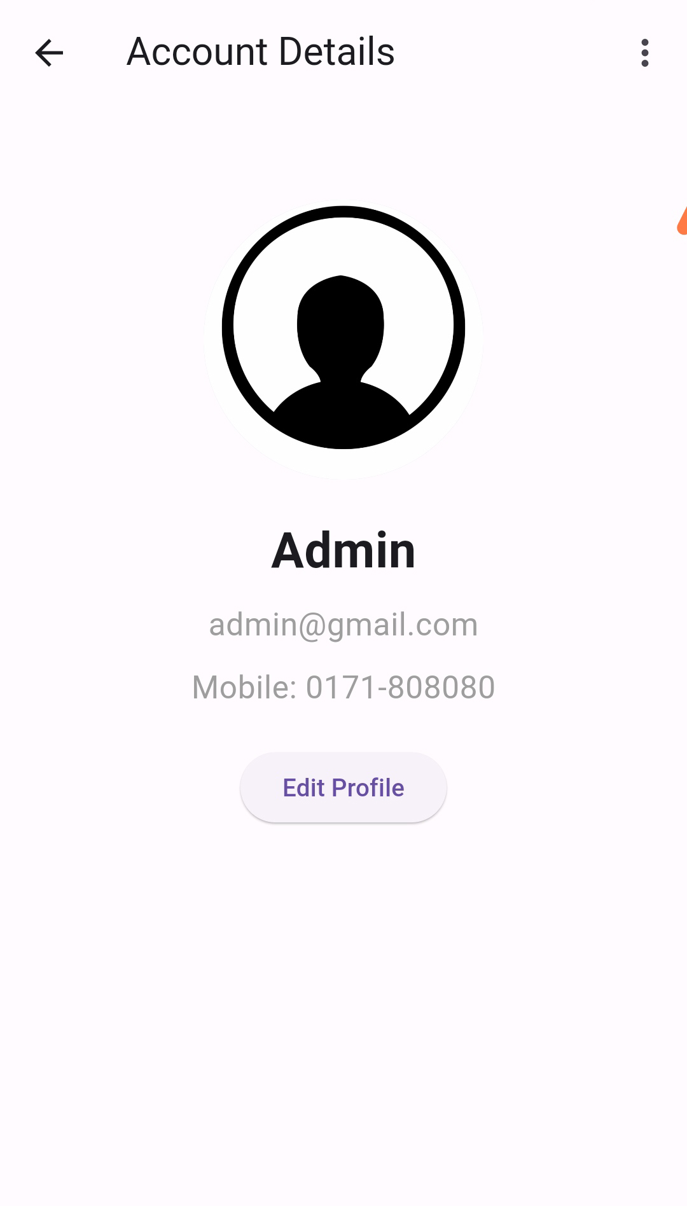
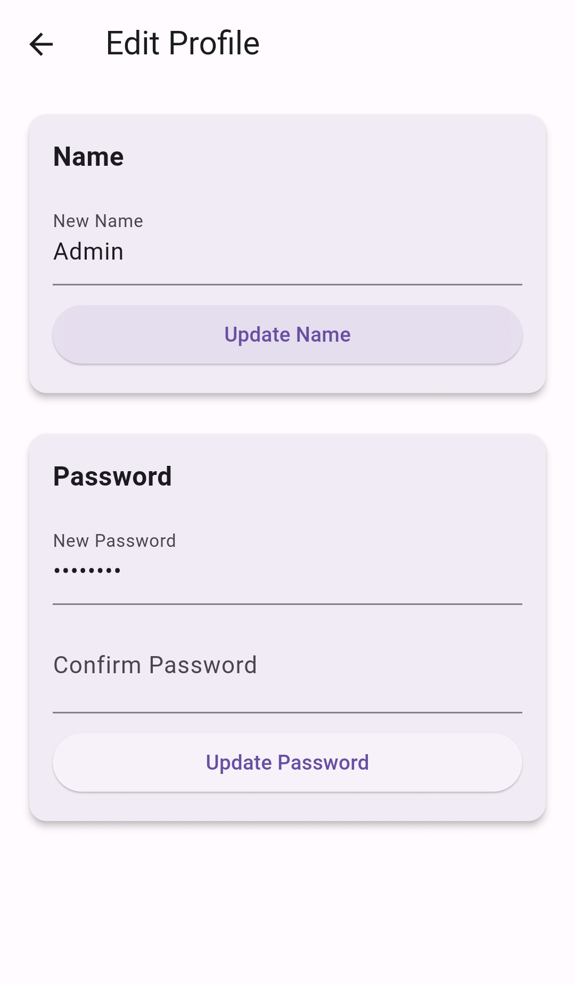
APP VIEW: ACCOUNT DETAILS
HOME PAGE
ACCOUNT DETAILS
EDIT PROFILE

Slide 12
THANK YOU!

